Slide 1
Familiarity with The Book of Common Prayer
History / Origins • What’s in it? • What is it for?

Slide 2
Your experience with the BCP?
And questions you are bringing with you?

Slide 3
The BCP: What Is It?
And what is it for?

Slide 4
The U.S. BCP is our Book; just one of many

Slide 5
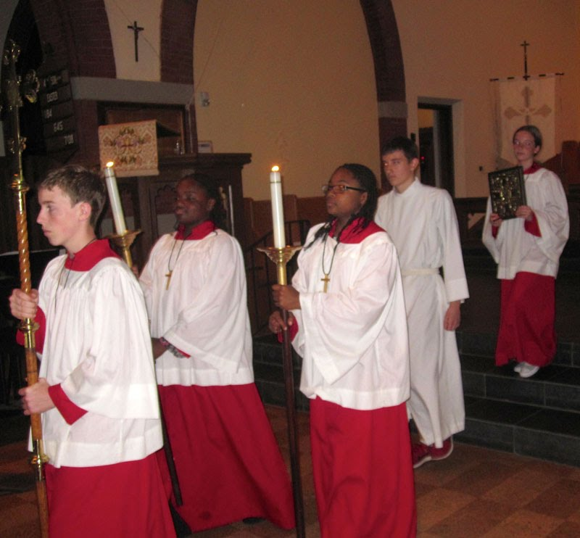
Worship
Provides for standard, uniform worship for all members of the Episcopal Church USA.
It’s why we can be said to have “common” prayer—

Slide 6
Liturgy, noun.
The act or ritual of worship itself.
The customary form(s) of worship in a religious tradition

Slide 7
Liturgy
noun. (from the Greek, leitourgios,
“work of the people.”)
Liturgy is “everyone’s business.”

Slide 8
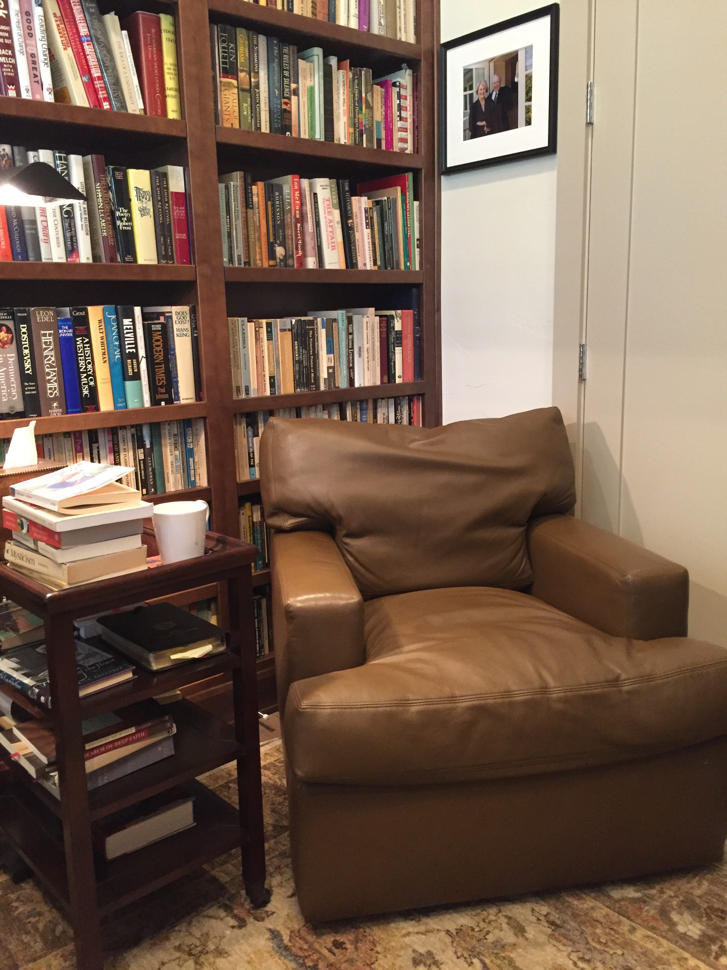
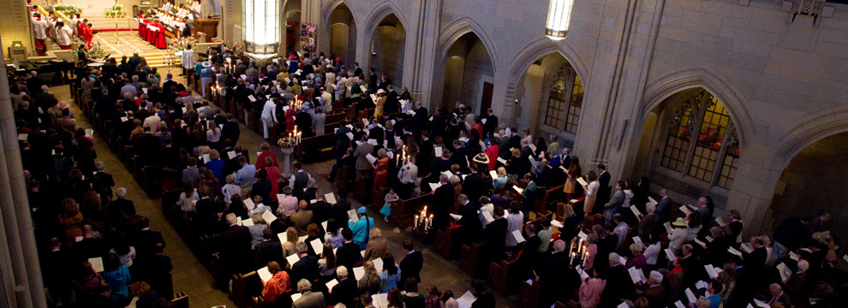
BCP Uses: Worship & Prayer
Public Worship – regulated by canon & rubric
Private Devotions

Slide 9
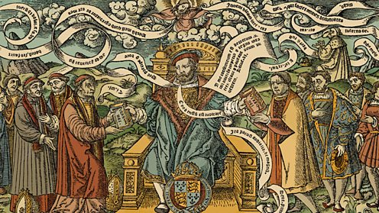
Language & Idiom
Original Book of Common Prayer: in English – for the English.
Left: Henry VIII authorizing the “Great Bible” – a complete English Bible for use in churches

Slide 10
Where Does it Come From?
(Just) A Bit of History

Slide 11
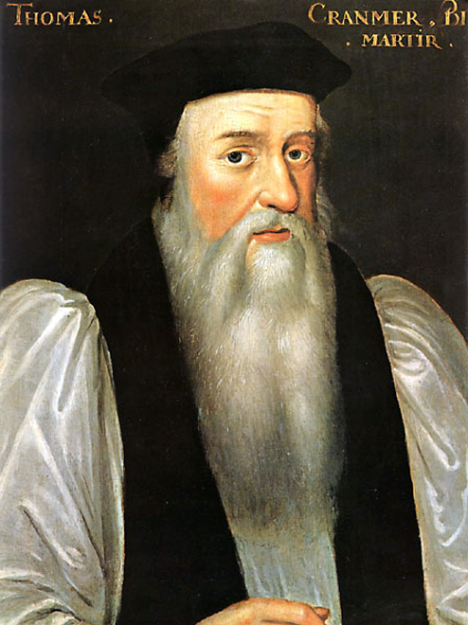
Principles
- Language / comprehensibility
- Apostolicity
- Tradition
- Reason
Above: Thomas Cranmer; widely regarded as the main framer of the first Prayer Book

Slide 12
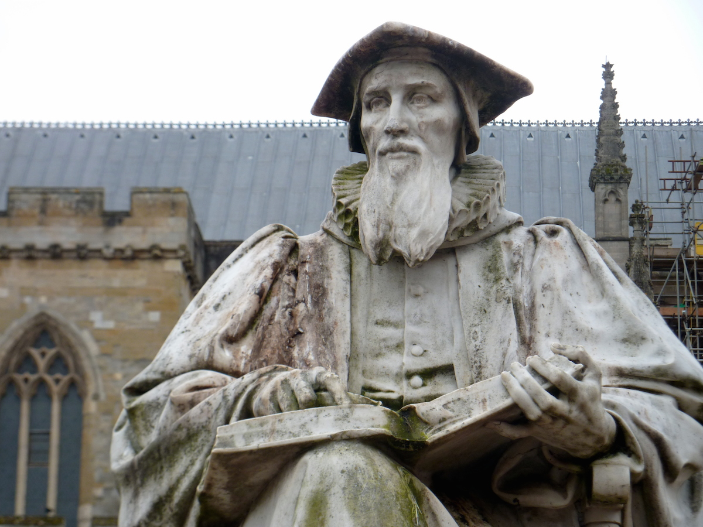
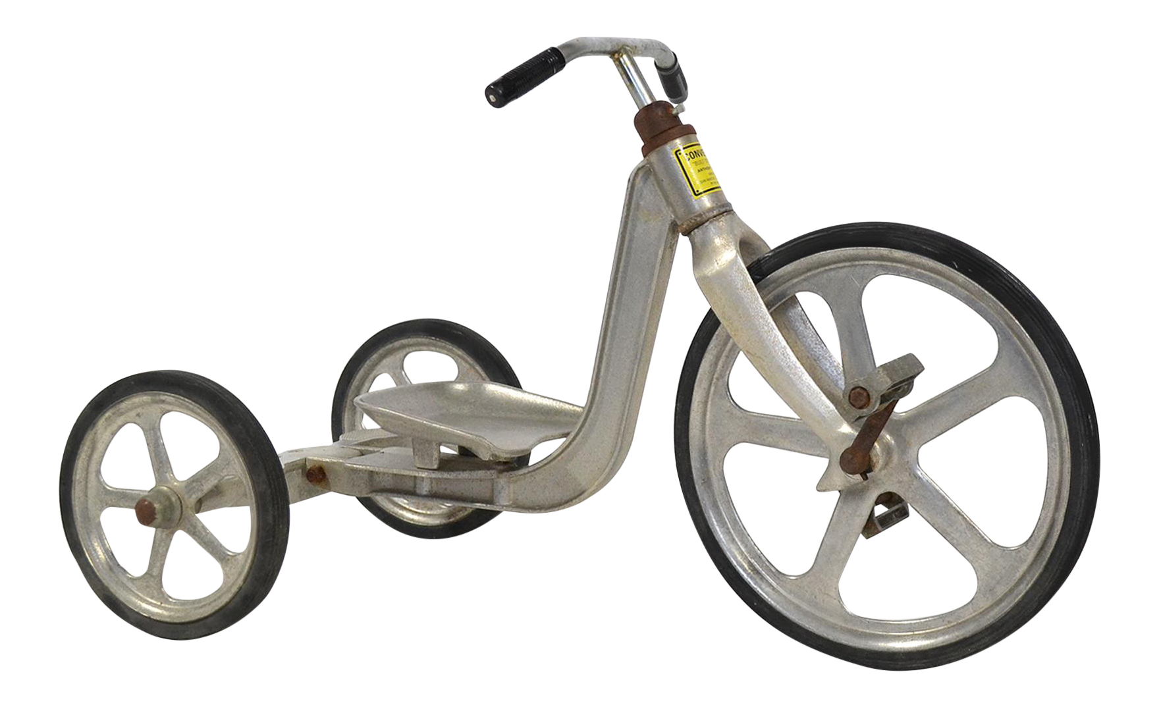
Hooker’s 3 Legged-Stool: Scripture, Tradition, Reason
Above: Richard Hooker,
Exeter Cathedral

Slide 13
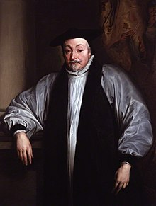
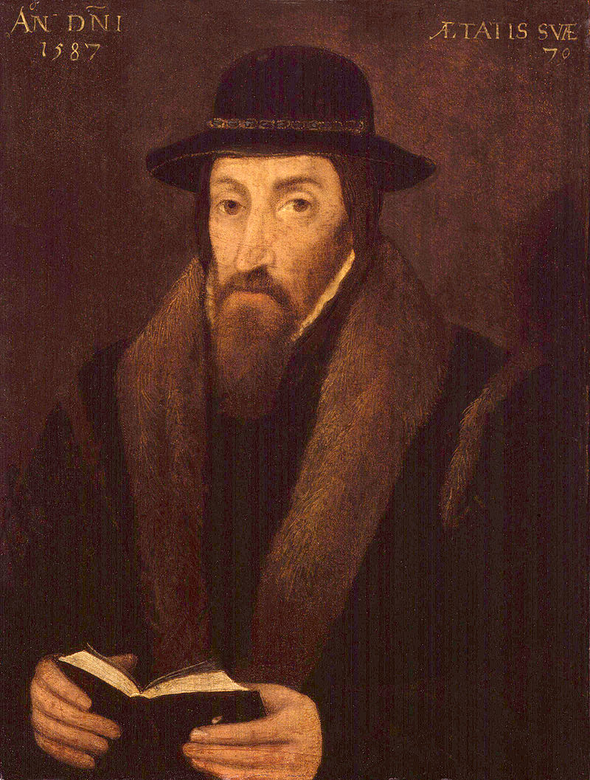
Opposing Tendencies
Catholicism ← -------- → Calvinism
Tradition ← ------ → Reform/Antiquity
Ceremonial ← ----------→ Simplicity
Adornment ← ---------- → Bareness
Sacramentalism ← ----- → “Bare Sign”
Establishment ← -- → Disestablishment
Above: Archbishop Laud Right: John Foxe

Slide 14
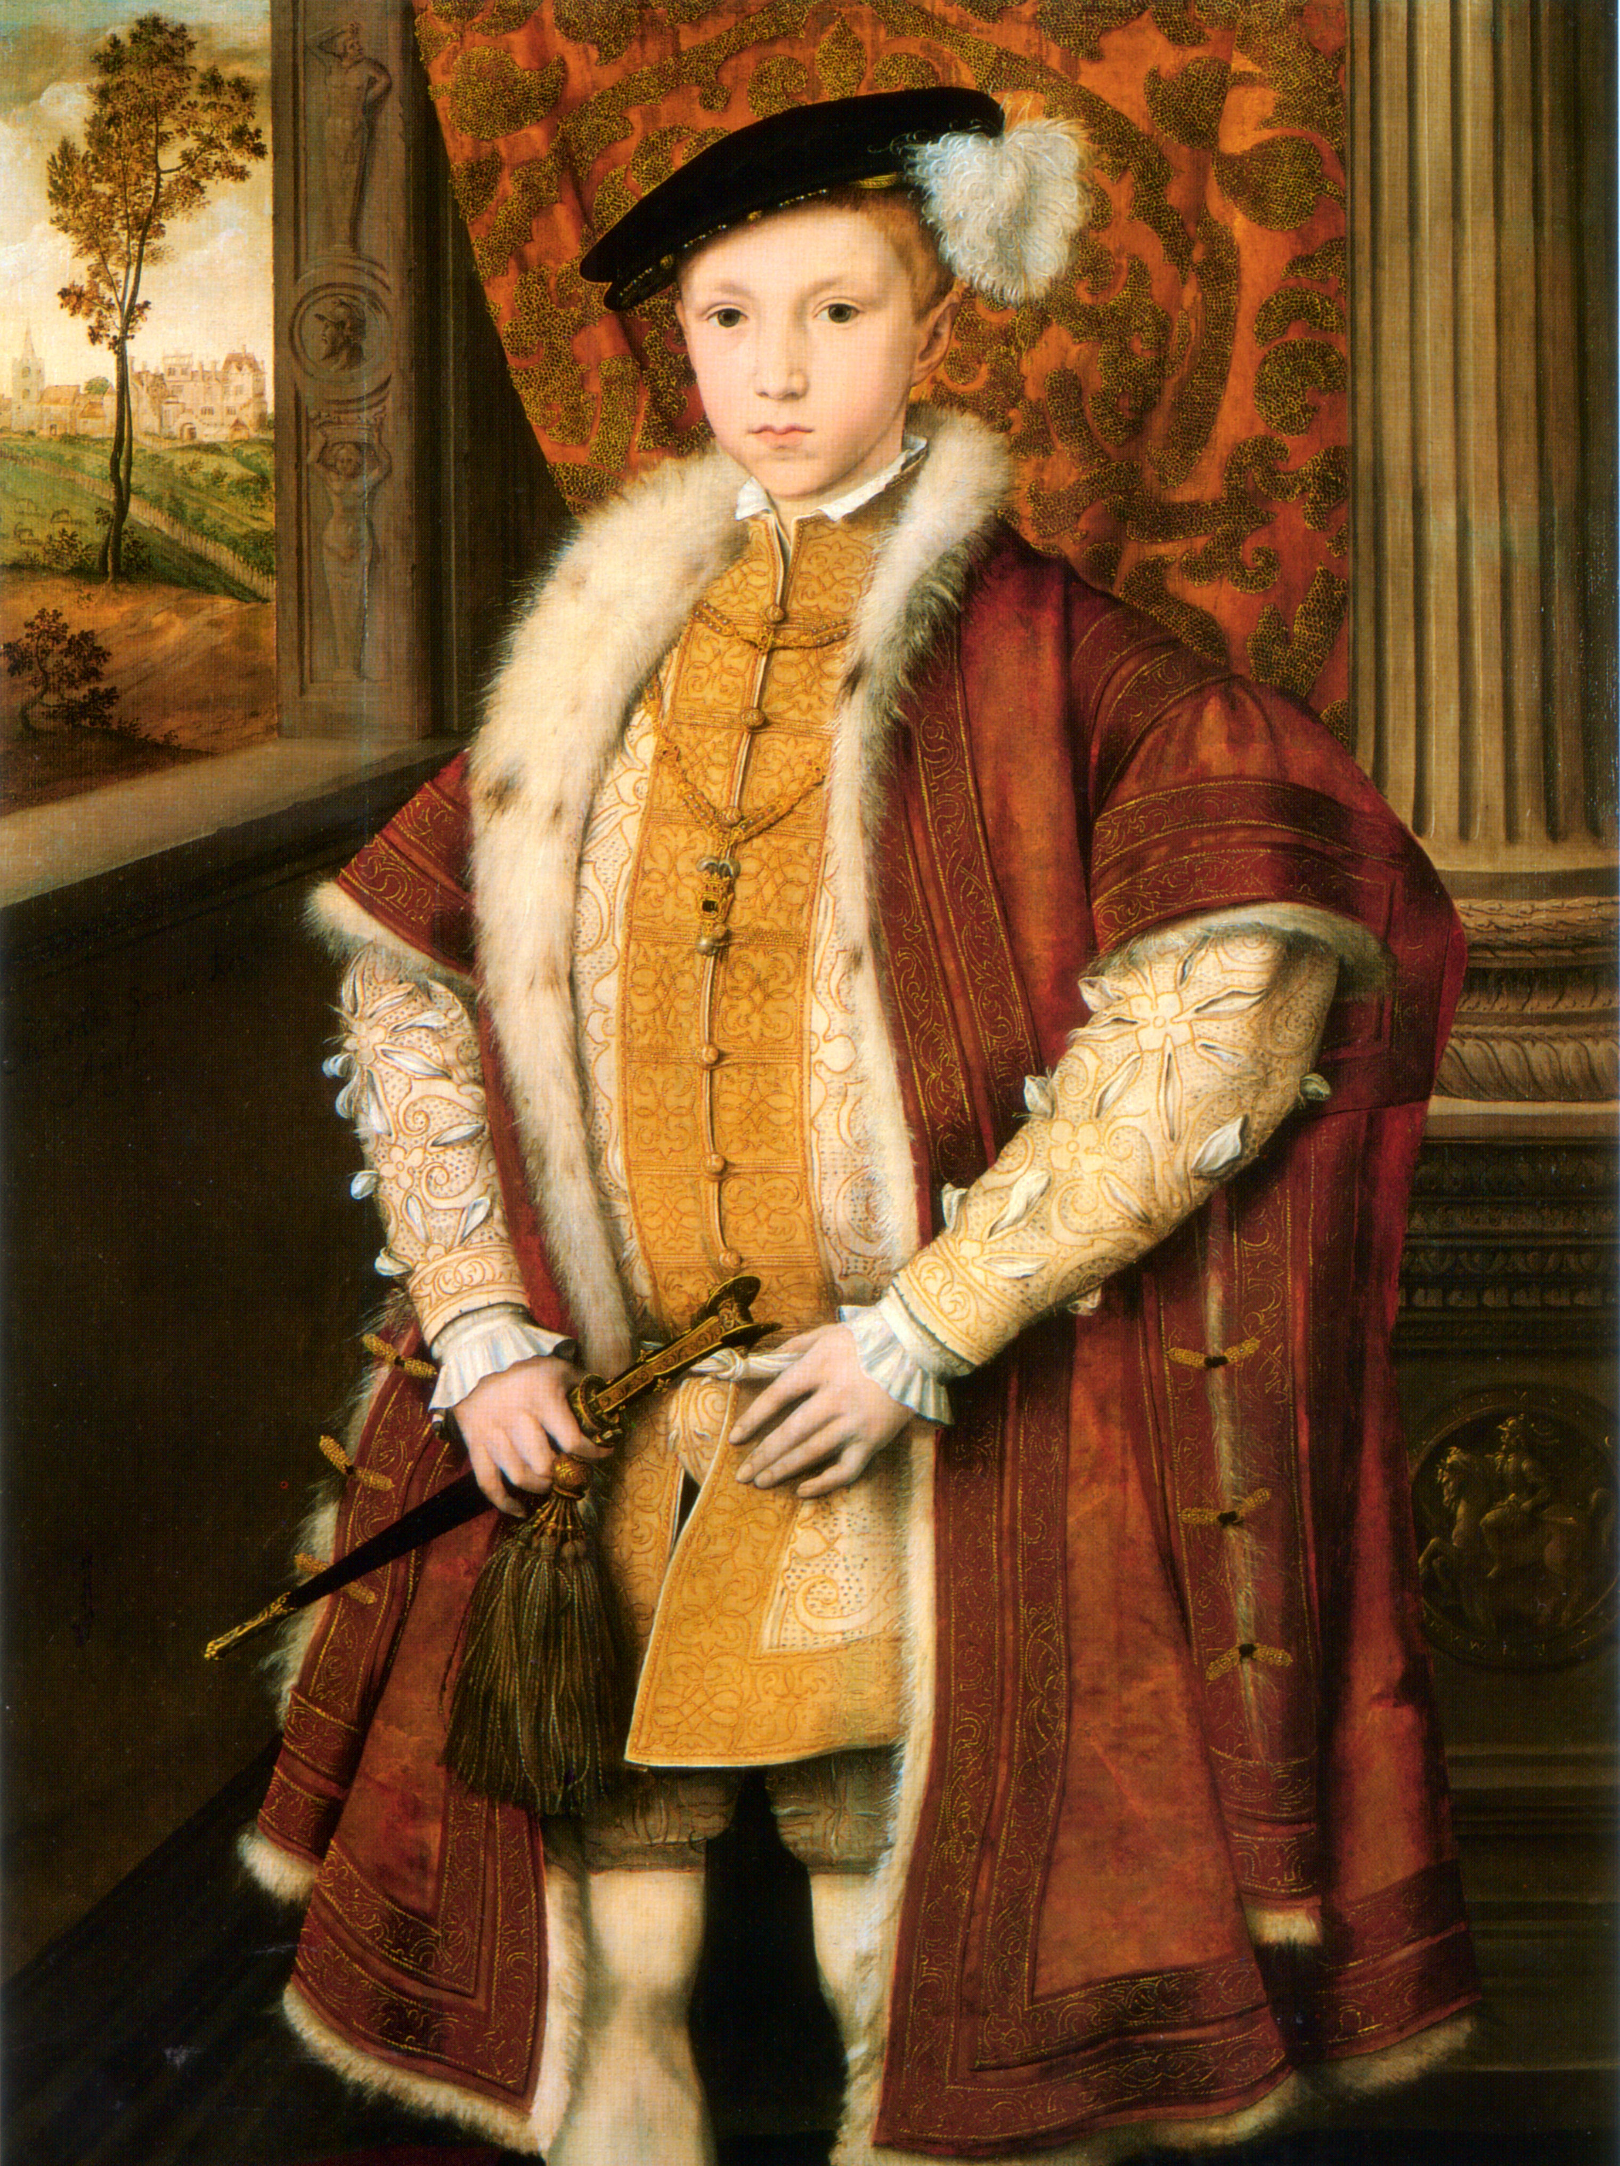
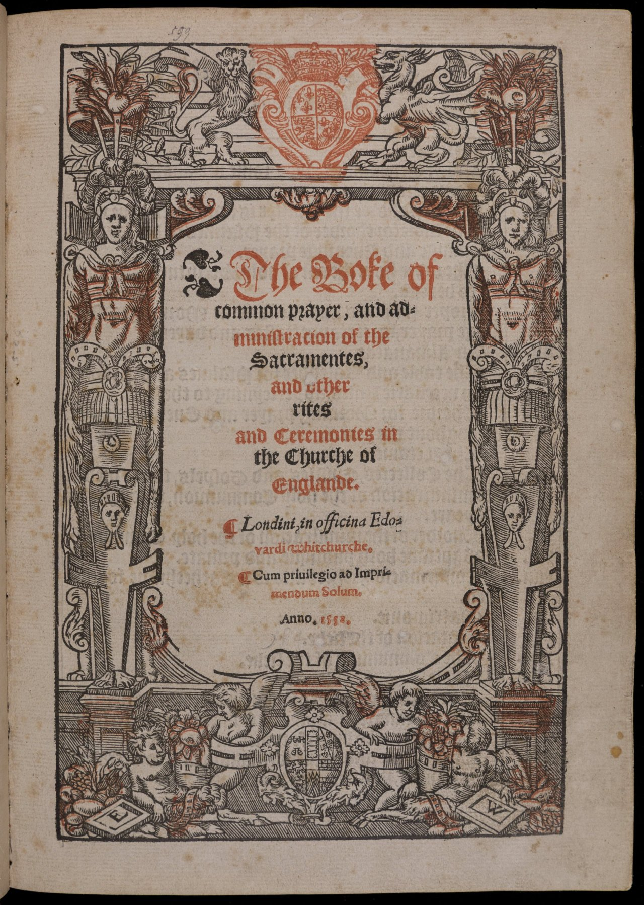
Edward vi: 1549, 1552

Slide 15
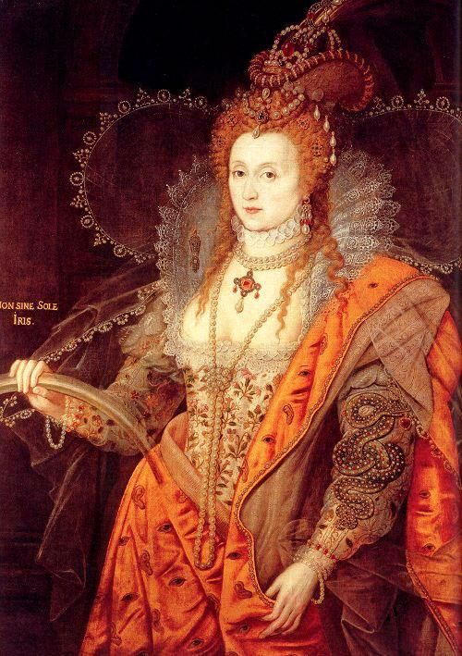
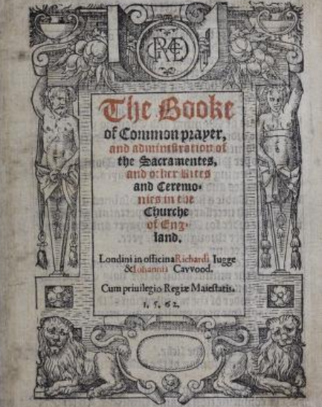
Elizabeth: 1559

Slide 16
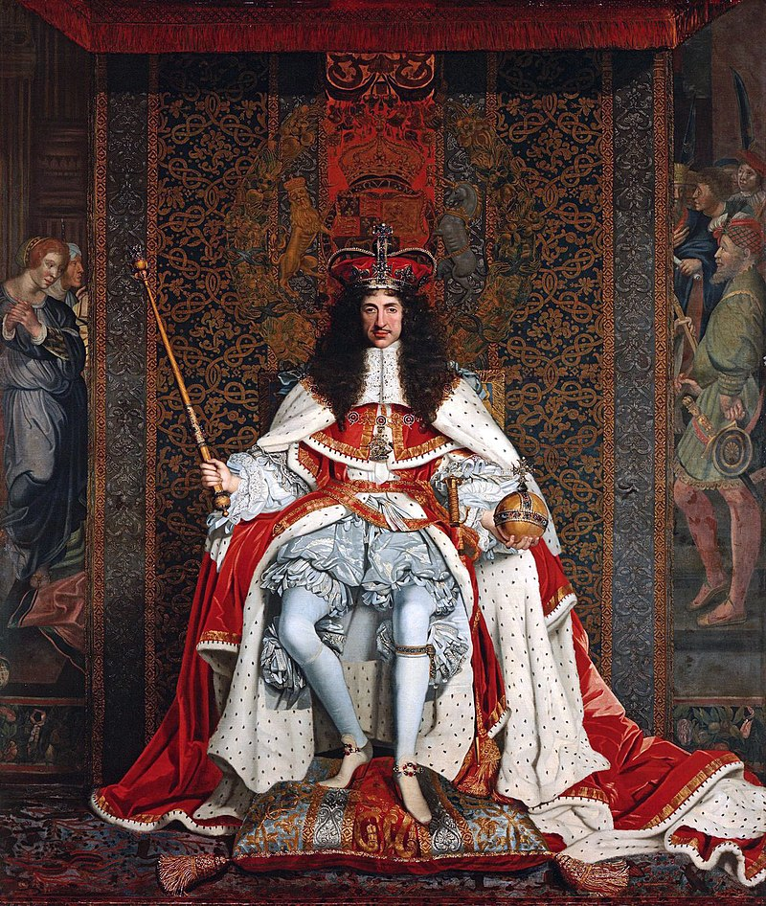
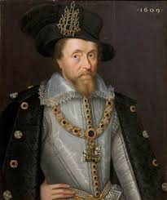
James: 1604
Charles: 1662

Slide 17
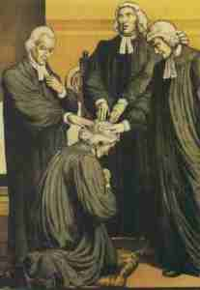
American Prayer Books (Episcopal Church)
1789
1892
1928
1979

Slide 18
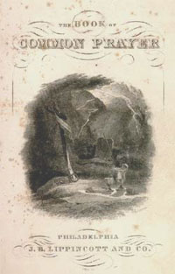
Preface to the 1789 (first U.S. BCP)
“The particular forms of worship, being things in their own nature indifferent, and alterable, and so acknowledged; it is but reasonable that upon weighty and important considerations according to the various exigencies of the times and occasions, such changes and alterations should be made therein, as those who are in a position of Authority should, from time to time, deem necessary or expedient… Yet so as that the main body and essential parts of the same have still been firm and unshaken. Yet upon the principles laid down, it cannot but be supposed that further alterations in time be found expedient.”
Draws justification for a new U.S.-specific Prayer Book from the English BCP’s prefaces and principles .

Slide 19
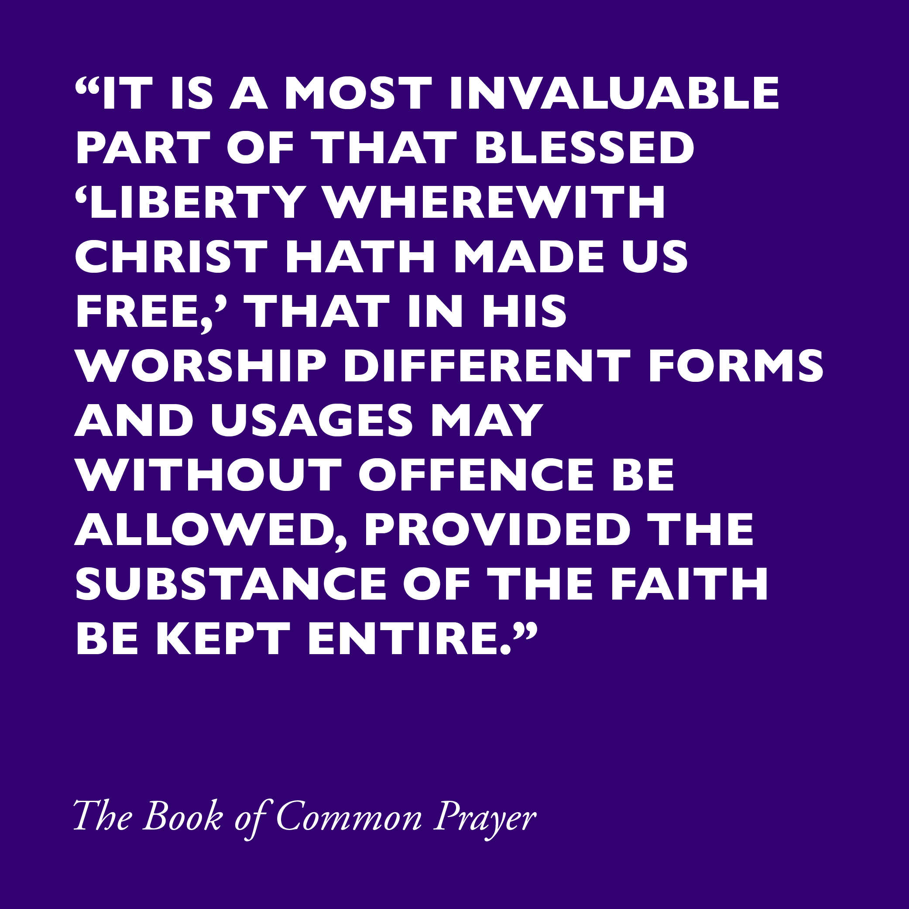
Similarly…

Slide 20
Sez Who?
Authority and liturgy in the Episcopal Church

Slide 21
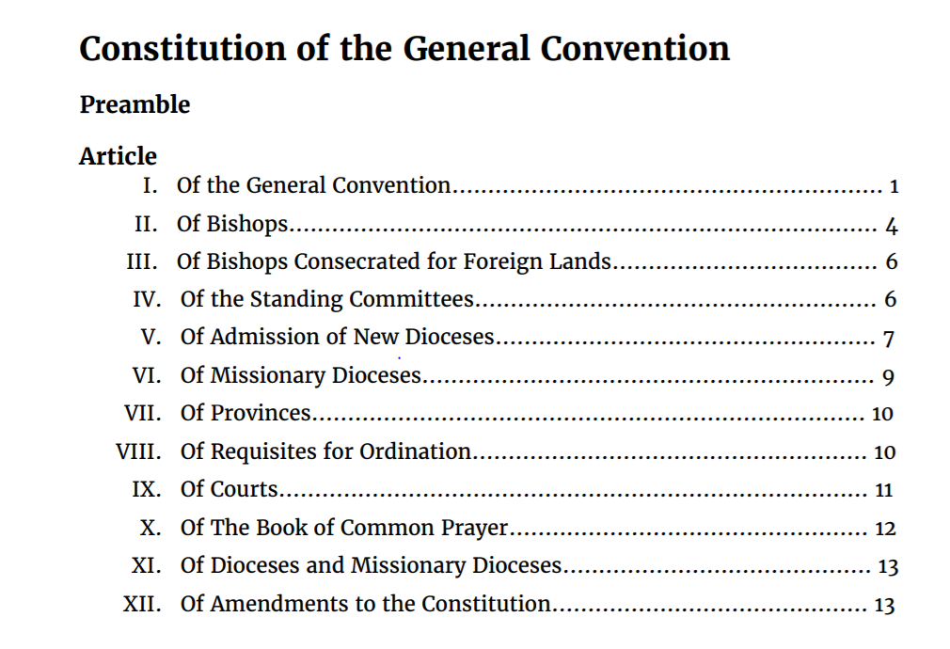
Episcopal Church Constitution& Canons…

Slide 22
Changes to the BCP…

Slide 23
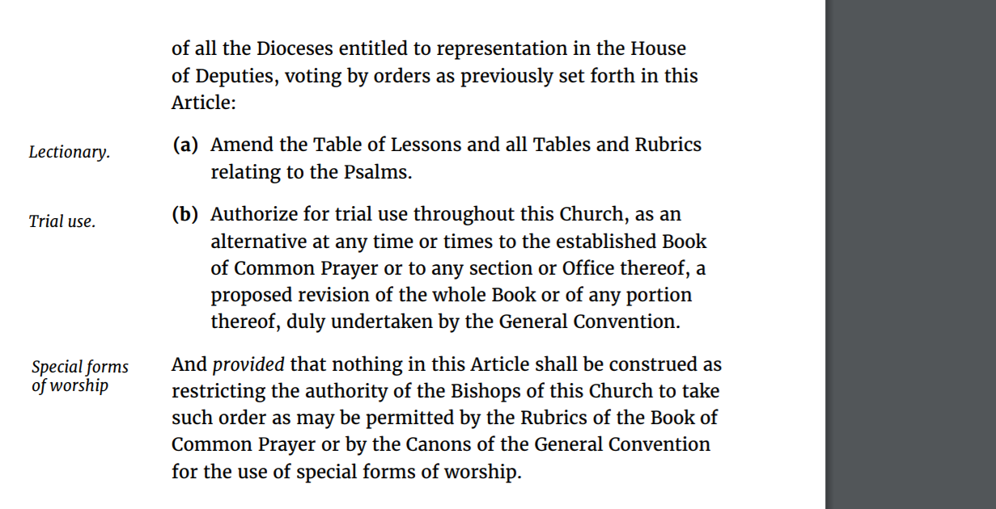
BUT…

Slide 24
“Trial Use” and Other Liturgies
Under the discretion of the Diocesan Bishop; different dioceses have their own standing policies on this…
CHECK LOCAL CANONS / CLERGY MANUALS!

Slide 25
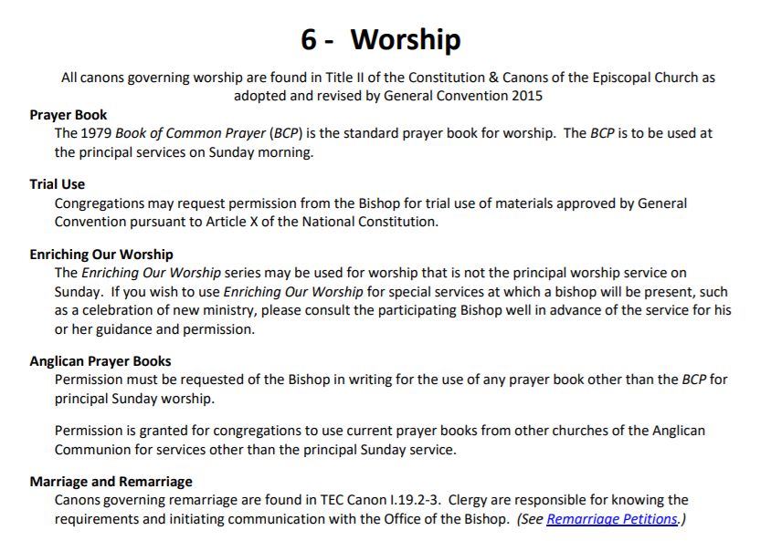

Slide 26
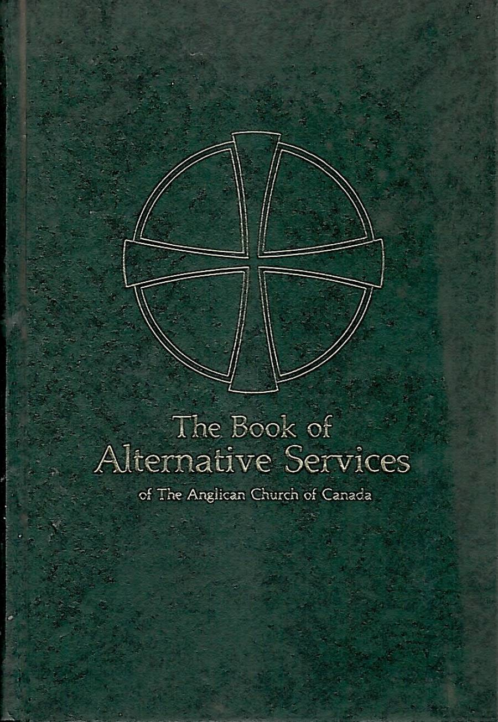
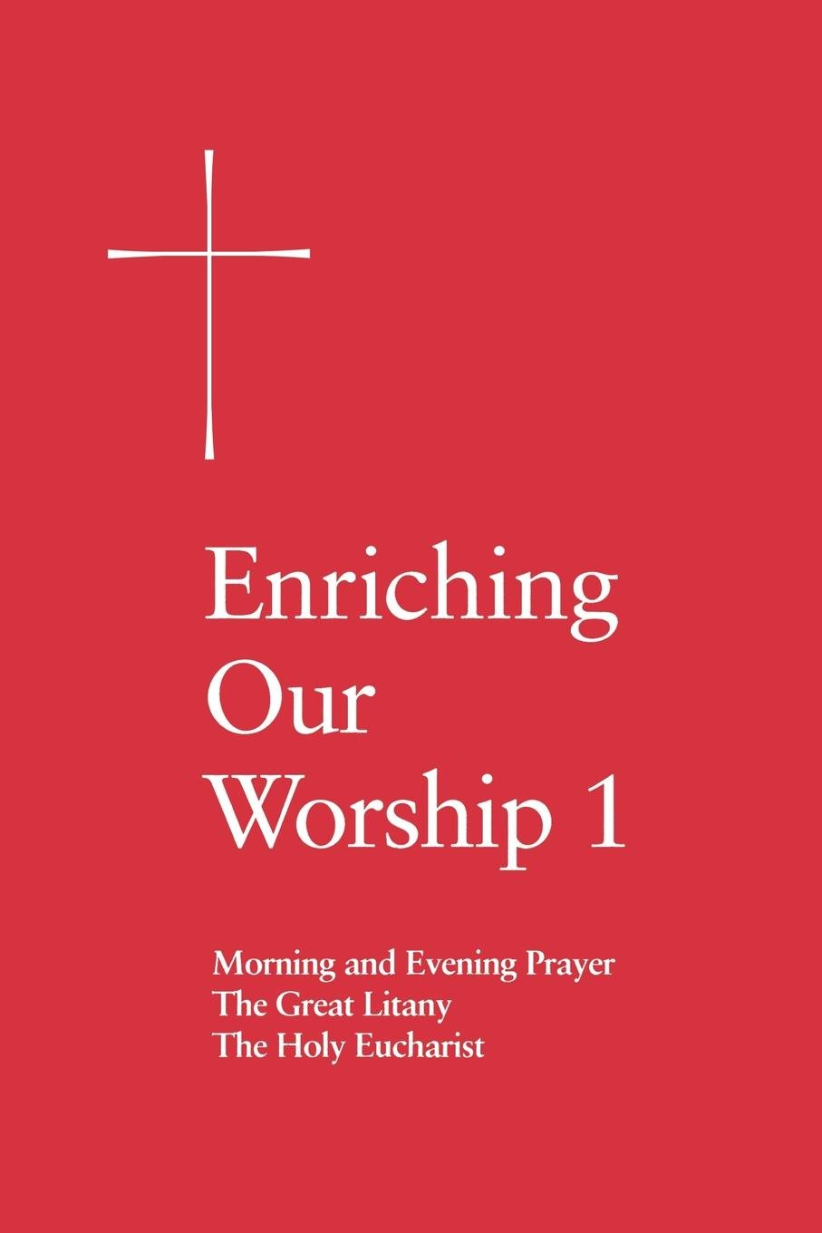
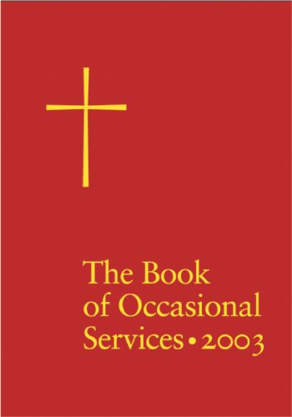
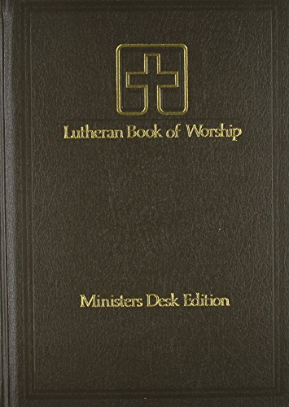
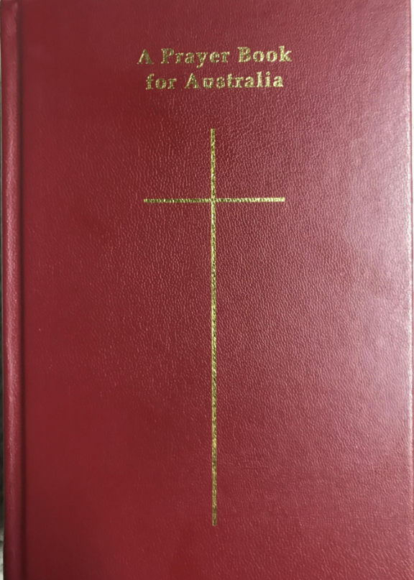

Slide 27
When in doubt… ask your Bishop! (or your bishop’s office)

Slide 28
What Is In It?

Slide 29
Contents: the basics categories The Daily Office (Prayers for times of day) Baptism The Holy Eucharist (Communion) Other Services (Confirmation / Marriage / Confession / Ordination / Anointing / Burial) Psalter – The Psalms of David…. & Even More Prayers Catechism, Historical Documents Calendar (at the beginning) The Lectionaries (at the end)

Slide 30
Contents: 4-minute rundown (Father Matthew Moretz)

Slide 31
Book of Common Prayer Scavenger Hunt
Or: Where is it, in the BCP?

Slide 32
“Big Things” : Working Alone, can you find…
The suggested collects for use after the Prayers of the People?
Psalm 40?
A “Penitential Order” for opening Eucharist, Rite 2?
The Great Litany?
Authorized ways to use the Psalms during services?
The Baptismal Covenant?
Reconciliation of a Penitent?
The Catechism?
A form for House Blessing?

Slide 33
“Big Things” : Working Alone, can you find…
The suggested collects for use after the Prayers of the People?
Psalm 40?
A “Penitential Order” for opening Eucharist, Rite 2?
The Great Litany?
Authorized ways to use the Psalms during services?
The Baptismal Covenant?
Reconciliation of a Penitent?
The Catechism?
A form for House Blessing?

Slide 34
“Medium-sized Things” : Who can find first…

Slide 35
“Medium-sized Things” : Who can find first…
“Proper Prefaces” for the Eucharistic Prayer, for Rite I?

Slide 36
“Medium-sized Things” : Who can find first…
“Proper Prefaces” for the Eucharistic Prayer, for Rite I?
The Offertory Sentences, for use with Rite 2?

Slide 37
“Medium-sized Things” : Who can find first…
“Proper Prefaces” for the Eucharistic Prayer, for Rite I?
The Offertory Sentences, for use with Rite 2?
The Collect for Ascension Day (Rite 2 service?)

Slide 38
Needles in haystacks: In your group, can you find…

Slide 39
group A group B group C
What to pray if you didn’t consecrate enough Eucharist?
The “Exsultet”?
Can I just “translate” Canticle 11 into “old-timey English” for Rite 1 Morning Prayer?
An invitation to a Holy Lent?
Can you observe St. Patrick’s Day as the main Sunday service?
How/whether to Baptize someone who isn’t sure whether they were baptized?
A Prayer attributed to St. Francis?
Can we sing what rubrics indicate are “said?” (or vice-versa?)
A deacon-candidate’s vows before ordination?

Slide 40
Takeaways
Points to remember

Slide 41
Remember, the Rubrics…

Slide 42
Remember, the Rubrics ARE YOUR FRIENDS!
…well,… ideally… …maybe…

Slide 43
If you treat ‘em right. (i.e., If you READ ‘em right…)

Slide 44
So, take time to ‘make friends’ with the BCP…
BEFORE the service!

